Slide 1
your best.

Slide 2
Lead the way - Awaken your best employees
Be the company to ensure your workers drive and arrive home safely
Breath new life into your company

Slide 3
The picture right now….
The number of people killed on our roads is growing. ACC get about 40,000 new injury claims a year from crashes on our roads
Fatalities and serious injuries have risen year-on-year for the past five years, with 473 people killed or seriously injured in 2017
Around 30% of all accidents involve drivers driving for work; this increases to more than 50% if you count people driving to and from work
Tailgating is the second most common cause of accidents in New Zealand
A study by the Department of Labour found that on average one in four work vehicles was involved in some kind of accident each year and in 2015 the Ministry of Transport estimated that each work-related vehicle injury accident costs a company $15,300

Slide 4
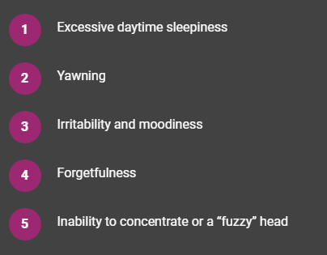
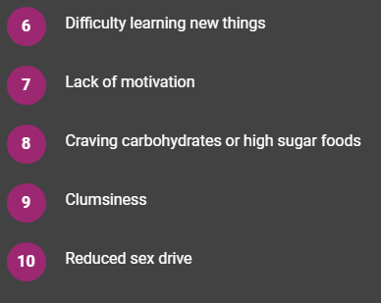
The symptoms of not enough sleep…..

Slide 5
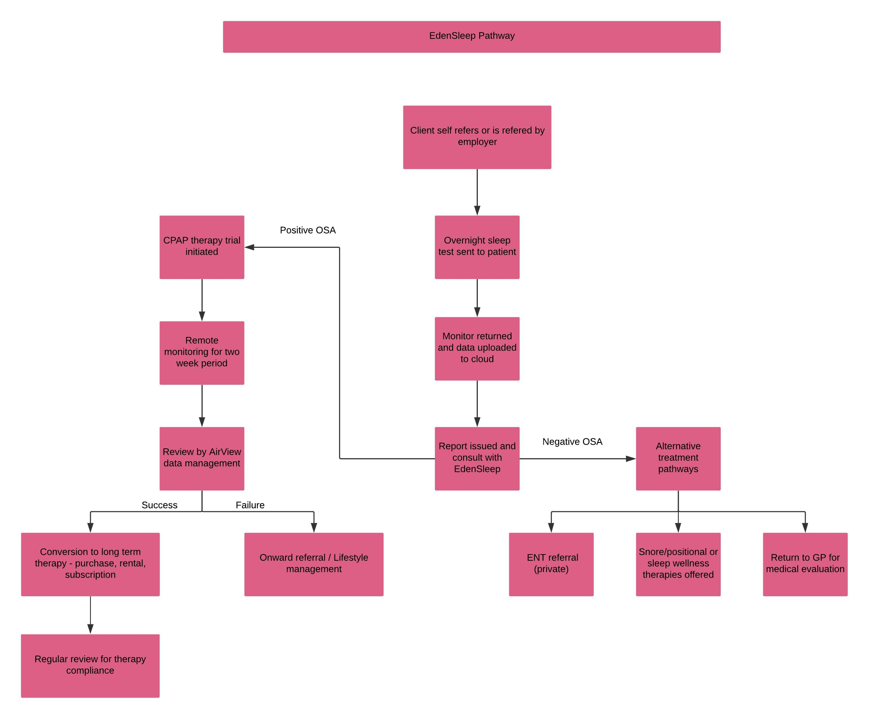

Slide 6
Take the ultimate sleep challenge
Help your team awaken their best from a better night's sleep with ResMed's 14 night sleep challenge
They can take part in this fun sleep challenge where they will learn some great tips and habits to help you improve their nightly routine and get a more restful sleep.
Ready to take the challenge?
Over the next two weeks they will receive hints and tips to help them improve your sleep habits
They will get to tell us if it helped them get a better night’s sleep and they get a report at the end

Slide 7
What is sleep apnea?
Apnea literally means “no breath” or “stopping breathing”. When you have sleep apnea, air stops flowing to your lungs for 10 seconds or longer – that is, you actually stop breathing.
This makes your blood oxygen level drop which in turn triggers your brain to wake you up just enough to take a breath. Then you fall back to sleep and the cycle begins again.
This can happen more than 30 times every hour and you may not even know it. As you can imagine, constantly being triggered back into breathing, hour after hour, night after night, can put a strain on your body. The next day you may feel tired and wrung out. Sleep apnea isn’t just an inconvenience. Left undiagnosed and untreated, it can have serious long-term effects on your health.
It’s so common! 3 in 10 men and almost 1 in 5 women have sleep apnea.

Slide 8
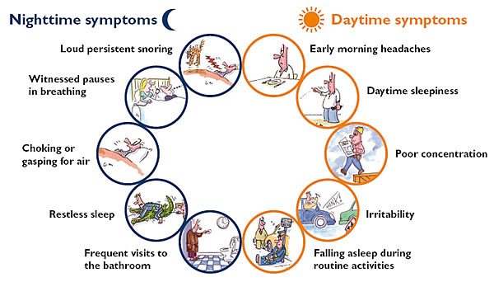
Symptoms of sleep apnea

Slide 9
What is a sleep test…..
What is a sleep apnea test?
A sleep test is the definitive way of diagnosing sleep apnea. It can identify what type of sleep apnea you may have and how severe it is. With advancements in technology there are now several ways you can do a sleep apnea test.
Who needs a sleep study?
Anyone who suspects they have sleep apnea should have a sleep study to put their mind at rest and decide what treatment, if any is required.
How to know if you need a sleep test?
If you snore loudly, gasp for breath or have been told you stop breathing while you sleep, you should have a sleep test to find out if you have sleep apnea.
If you feel constantly tired or keep falling asleep during the day, it might be because you have undiagnosed sleep apnea, so this could be another reason to have a sleep test.

Slide 10
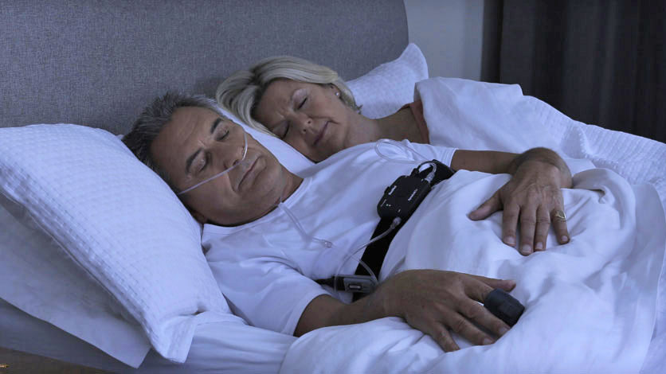
Home sleep testing made easy…..

Slide 11
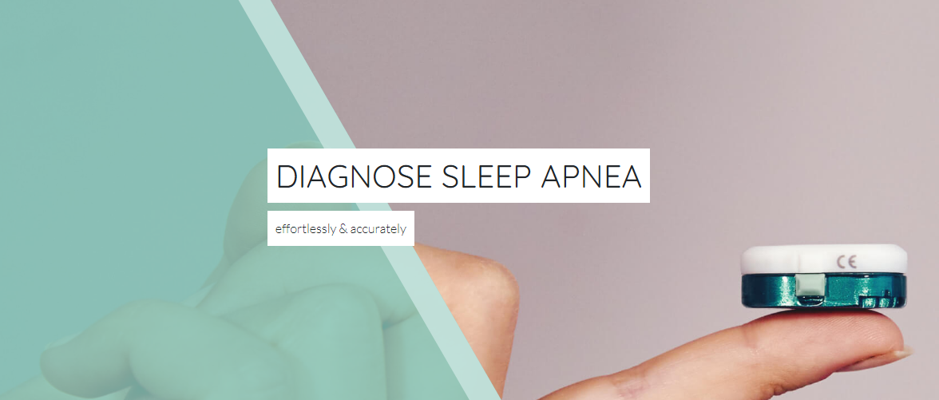
And then even easier…..

Slide 12
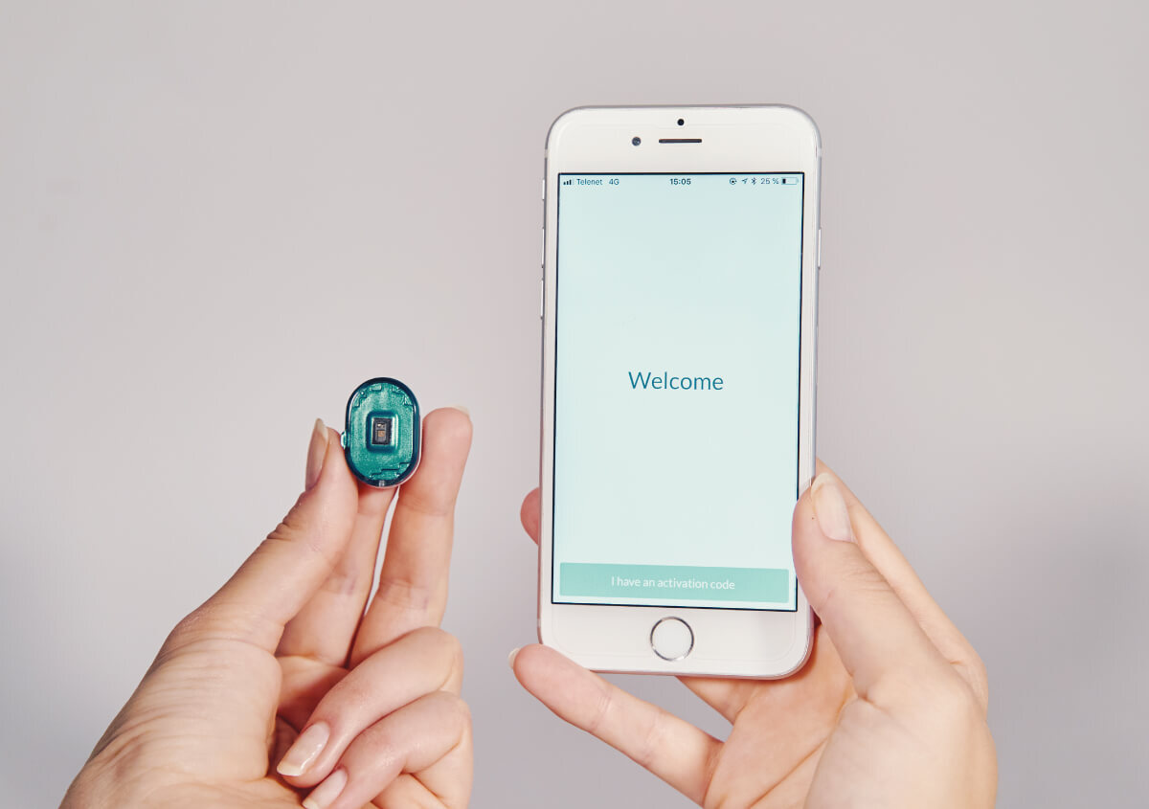
Home sleep testing with NightOwl sensor

Slide 13
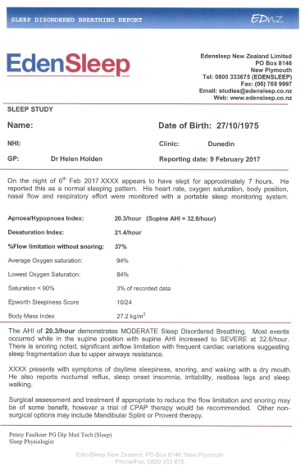
Simple and easy to understand sleep test results…..

Slide 14
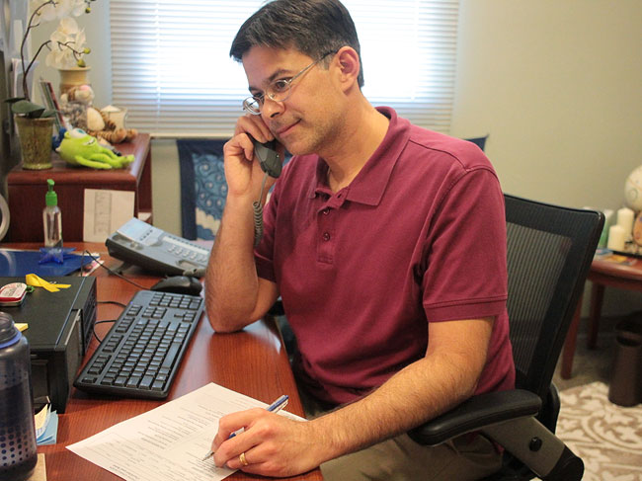
A follow up consultation with trained sleep staff…..

Slide 15
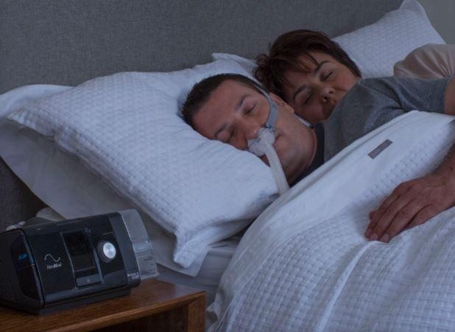
How is sleep apnea treated…..
CPAP, or Continuous Positive Airway Pressure, treats breathing problems such as sleep apnea and chronic snoring, giving people healthier sleep and helping them enjoy better daytime alertness.
CPAP applies mild air pressure to a person's upper airway to keep their airway open so that they can breathe normally while they sleep.

Slide 16
The EdenSleep Delight nurture program
Completed Online Sleep Assessment
Ordered Home Sleep Tests
CPAP Trial to Purchase
Purchase to Re-purchase
After users complete online sleep assessments receive automated results and are supported with further information including:
Next steps to looking after their sleep
Series of email nurtures to encourage ordering Home Sleep Test
Users are supported to take Home Sleep test, and motivated to go on to take a CPAP trial
Receive emails to encourage and support with HST (unboxing video)
Directed to website pages offering detailed information on what to expect and how to use Home Sleep Test
After HST is complete, receive a series of email nurtures introducing sleep apnea treatment, and motivational user success stories
Users on a CPAP trial are supported with information on what to expect, tips to help them complete successful trial and what are the next steps
Information on how to fall asleep on therapy
Tips to getting used to your mask plus remote support
Other user experiences and benefits of treatment
What next? Purchasing online and subscription plan options
After purchasing CPAP equipment, users enter onboarding journey to support them on their sleep therapy journey
Invited to join support communities
Invited to join sleepVantage onboarding program
Sent a series of loyalty and value emails

Slide 17
Remotely accessed rapid pathway

Slide 18
In summary
Why choose EdenSleep?
We have spent 20 years helping people in NZ improve their sleep and awaken their best and now as part of ResMed we can use medical technology to drive innovative solutions to new clients wherever they live.
Is sleep this important?
Sleep plays a vital role in good health and well-being throughout your life. Getting enough quality sleep at the right times can help protect your mental health, physical health, quality of life, and safety. During sleep, your body is working to support healthy brain function and maintain your physical health
How do we get EdenSleep to help our staff?
You can talk to us about a service tailored just for your business or you can just refer individuals to us or you can just give information we have available to your team members and they can contact us directly.

Slide 19
your best morning.
Edensleep.co.nz
office@edensleep.co.nz
0800 333675

